Slide 1

ADF Business Components
(Section 2)
Understanding the runtime behavior of ADF Business Components

Slide 2
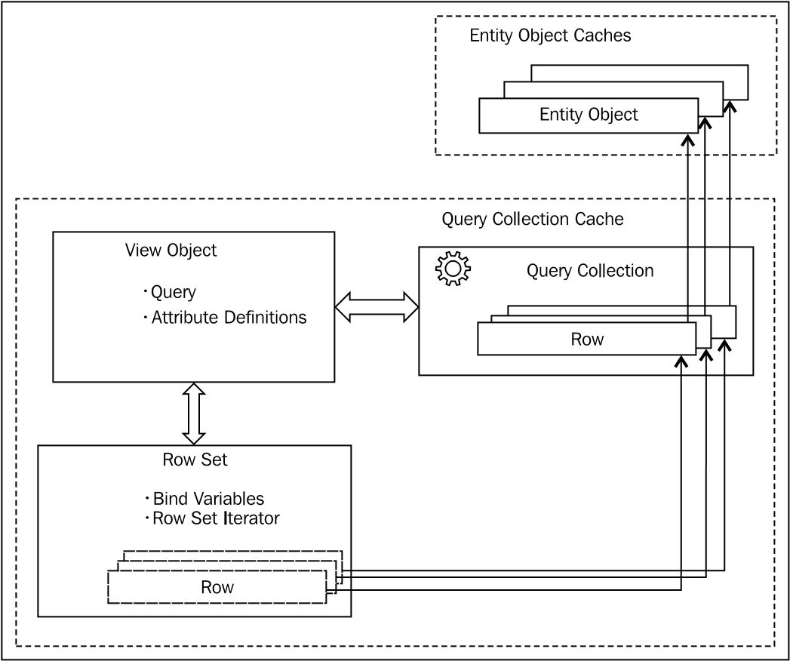
view object, row set, and query collection

Slide 3
view object, row set, and query collection
A view object contains a query to read records from the database. The framework may use the same view object in multiple places to query the datasource with a different set of bind variable values.
All row sets that belong to a view object use the same query statement supplied by the view object, but with a different set of bind variable values supplied by the caller.
when a client executes a view object multiple times, the framework populates the default row set each time.
The actual query execution and caching of rows is done by a query collection class. Each row in a row set acts as a wrapper over rows from the query collection.

Slide 4
A closer look at query collection
When a view object or row set instance is queried for collection, the view object checks an internal query collection hash table to see if a query collection for the row filter key is already in the list, and if found, re-uses it. Otherwise, the query is executed and a new query collection is generated.

Slide 5
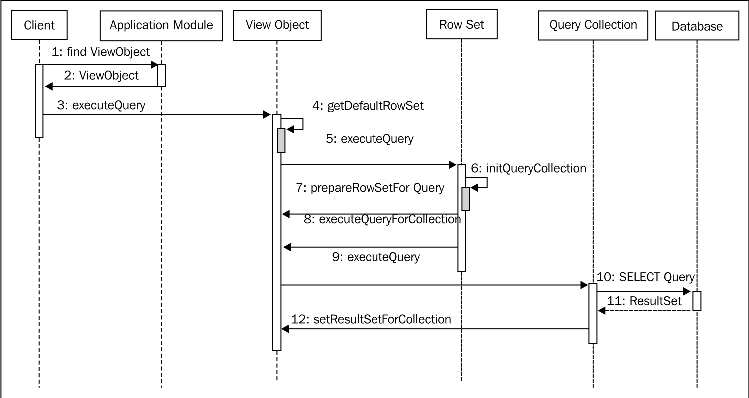
What happens when you execute an entity-based view object?
ViewObject vo = applicationModule.findViewObject("Departments"); vo.execute();//execute view object to fetch rows Row row=vo.first();//Move to the first row in the row set

Slide 6
What happens when you execute an entity-based view object?
The client then executes executeQuery() The view object finds the default row set and delegates the call. When any view object calls executeQuery() on a row set, it does the following tasks:
Row set will check the associated view object instance to see if a query collection for the search parameters (row filter) is already available. If yes, use the same query collection object.
If it does not exist, then a new query collection will be created and this will be added to the view object.
The row set instance calls prepareRowSetForQuery() on the view object first. This is followed by a call to executeQueryForCollection() on the view object. The query collection executes the query by using Java Database Connectivity (JDBC) APIs and gets the result set back.
By calling first() on the view object instance The query collection starts generating a view row for the first item in the result set. While creating the row, if the view object definition is based on an entity object, entity instances will be created and added to corresponding entity cache.
The next step is to populate the newly created entity instances with values from the row in the result set.

Slide 7
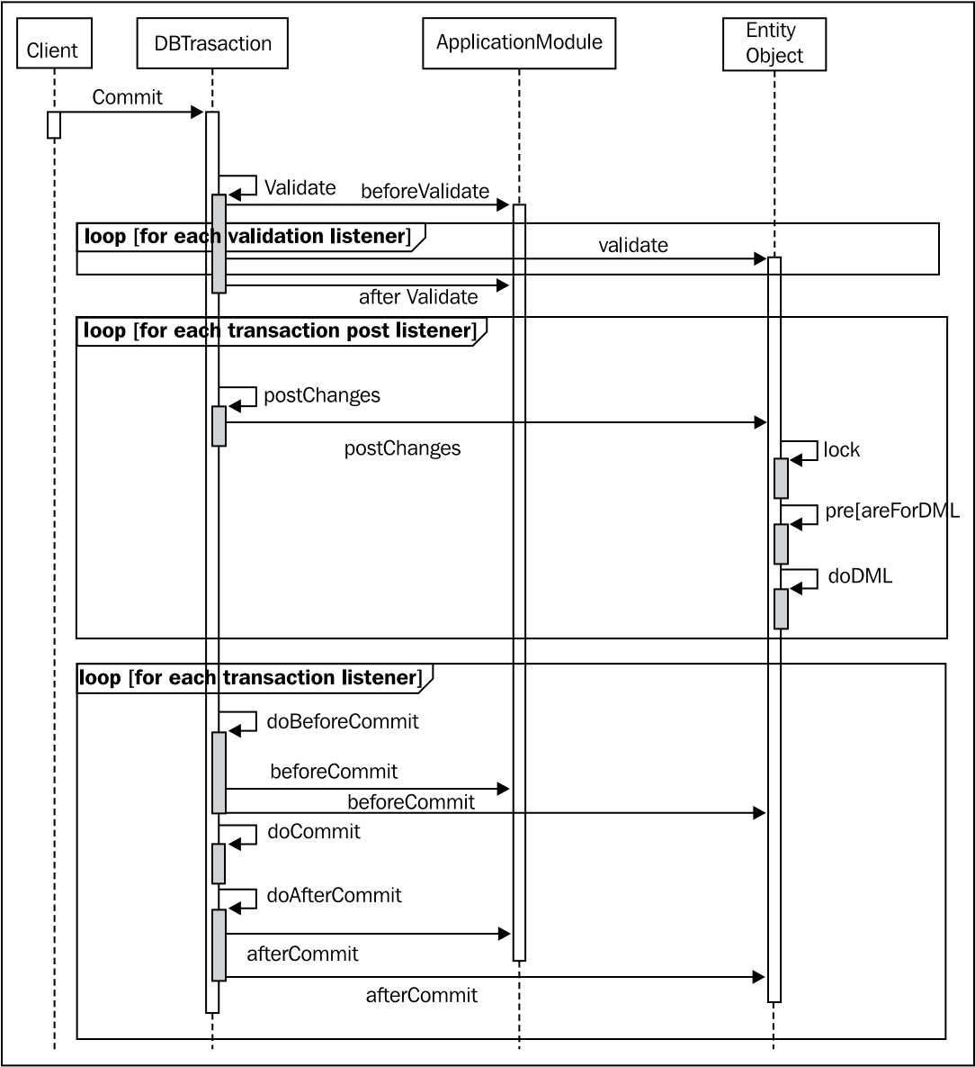
What happens when you commit a transaction?

Slide 8
What happens when you commit a transaction?
ViewObject vo = applicationModule.findViewObject("Departments"); vo.executeQuery();
Row deptRow = vo.first();
deptRow.setAttribute("DepartmentName", "HR Service");
applicationModule.getTransaction().commit();
When you modify the attribute value by calling setAttribute() on a row, the call reaches the underlying entity instance on which the row is based. At this stage, the following actions happen:
The framework pushes the modified attribute value to the entity instance.
Then, marks it as modified.
Runtime adds the modified entity instance to the transaction listener list and to the validation listener list
Later, when you commit changes by calling commit() on a transaction, the following steps are triggered behind the scenes:
The DBTransaction object triggers the validate phase.
Transaction manager starts the data post cycle. During the post changes cycle, the framework performs the following tasks:
Locks each modified entity
Generates native SQL for data manipulation based on the type of operation and modified attributes
Executes JDBC statements, which post modified data to the database

